Slide 1
2018-2 Design Patterns Term project
Game of life by edwinm

Slide 2
Original program Game-of-Life-in-Java by edwinm
Cellular automaton by John Horton

Slide 3
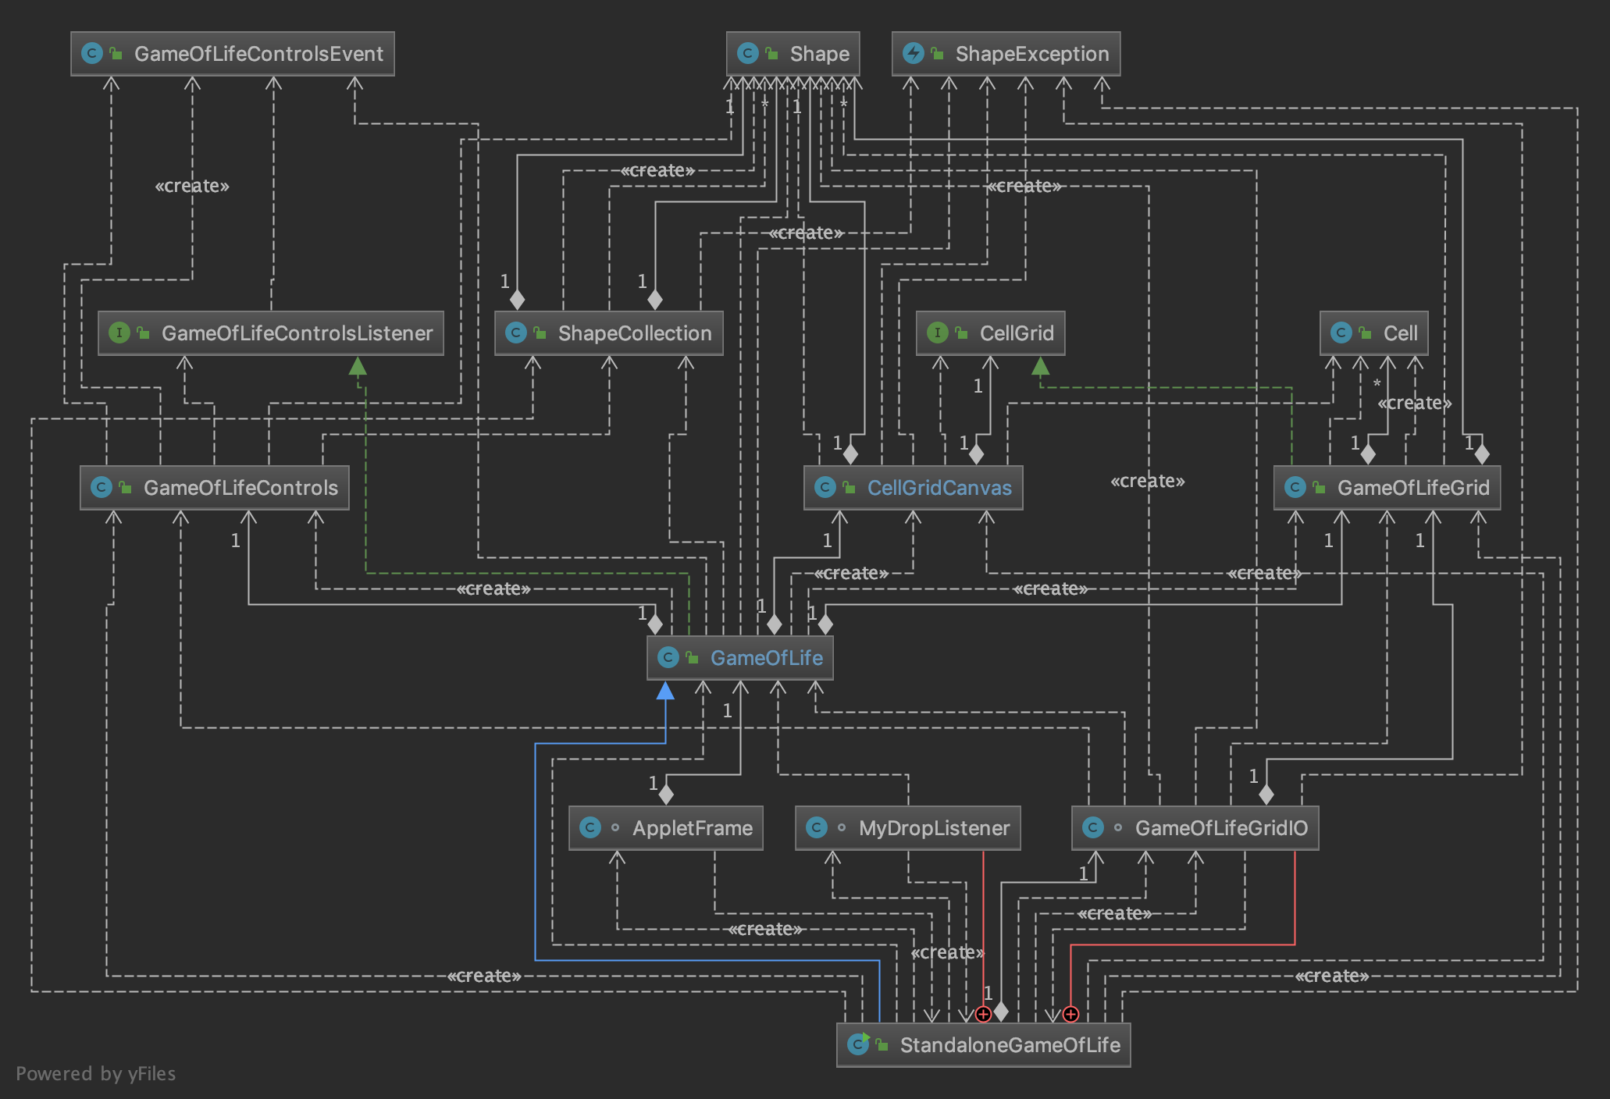
Limitation of original project

Slide 4
Limitation of original project 1. shape class 의 의존성
원본 프로그램에서 shape class 의 의존성이 강하다.

Slide 5
Limitation of original project 2. Hard coding

